Slide 1
Social Data Institute
Continuing Professional Development (CPD) course
Introduction To Bayesian Inference & Modelling (June 2025)
Day 2: Introduction to Bayesian Generalised linear models (glm)
Dr Anwar Musah (a.musah@ucl.ac.uk)
Lecturer in Social and Geographic Data Science
UCL Geography
Additional details:
https://www.ucl.ac.uk/social-data
1

Slide 2
Social Data Institute
Contents
Problem
What are Generalised Linear Models (GLMs)?
Link functions
Selecting the appropriate type of statistical model
Linear regression model
Logistic regression model for Bernoulli OR Binomial
Poisson-based regression models (Normal, Negative Binomial & Zero-Inflated)
What does each statistical model do?
Linear relationships
Log-odds and Odd Ratios (ORs)
Relative risk ratios (RRs)
Interpretation of coefficients
Model Specification from a Bayesian Framework
Knowledge
Collect
Model
Wrangle
Explore
2

Slide 3
Multivariable linear regressions
3

Slide 4
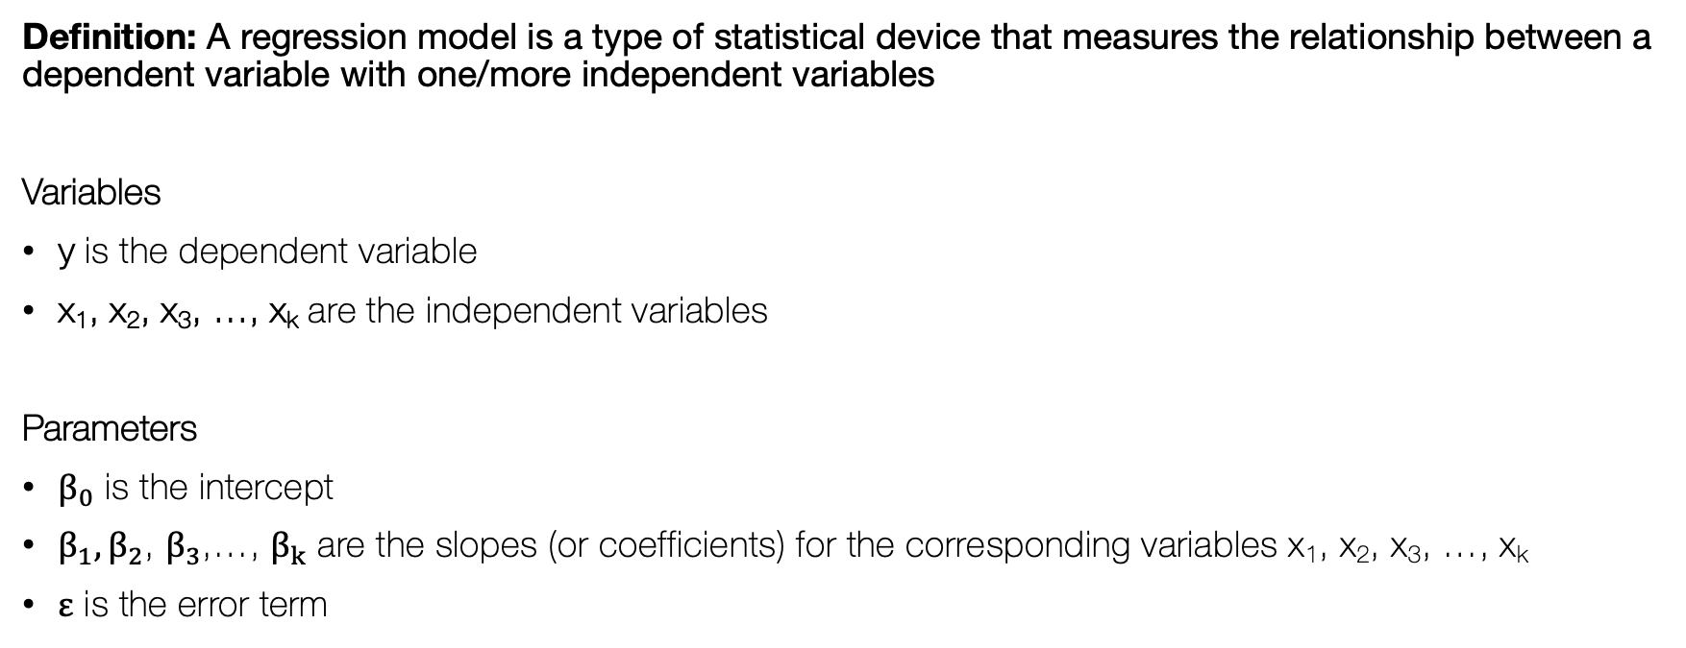
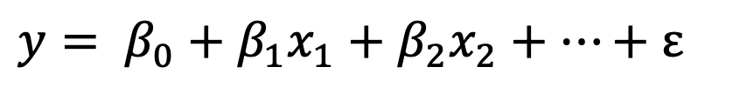
Multivariable Linear Regression Model
Social Data Institute
$$y= β_{0}+β_{1}x_{1}+β_{2}x_{2}+…+ε$$
Definition: A regression model is a type of statistical device that measures the relationship between a dependent variable with one/more independent variables
Variables
y is the dependent variable
x₁, x₂, x₃, …, x_{k} are the independent variables
Parameters
$β_{0}$ is the intercept
$β_{1},β_{2}$, $β_{3}$,…, $β_{k}$ are the slopes (or coefficients) for the corresponding variables x₁, x₂, x₃, …, x_{k}
$ε$ is the error term
4
Notes:
“…it allows you to see the relation between X values and observed values of Y”

Slide 5
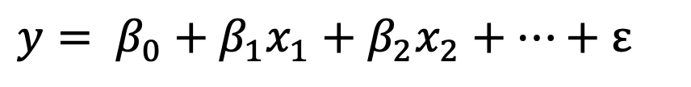

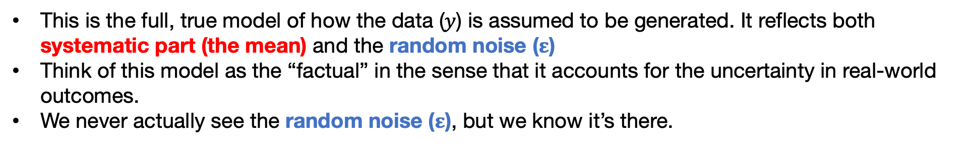
Important notes
Systematic part
Error part
[1] Model with the error term:
$$y= β_{0}+β_{1}x_{1}+β_{2}x_{2}+…+ε$$
This is the full, true model of how the data ($y$) is assumed to be generated. It reflects both systematic part (the mean) and the random noise ($ε$)
Think of this model as the “factual” in the sense that it accounts for the uncertainty in real-world outcomes.
We never actually see the random noise ($ε$), but we know it’s there.
(Expected average)
Only the systematic part
[2] Model without the error term:
$$𝔼\left[Y\right]= μ = β_{0}+β_{1}x_{1}+β_{2}x_{2}+…$$
This is the model that we use to predict the expected value of our data (i.e., $y$). What we are saying is that it’s best guess (on average) of what 𝑦 will be, without the random noise ($ε$).
This is not the full model – its only a fitted/predictive model.
5
Notes:
Some notes to establish some distinctions from the get go!

Slide 6
In terms of regression, there are several types of models, each with there own families depending on the type distribution for the dependent variable:
Here is a board overview:
Distribution of dependent variable | Suitable Model
Continuous measures: e.g., average income in postcode (£); concentrations of ambient particulate matter (PM2.5); Normalised Vegetative Difference Index (NDVI) etc., | Linear regression
Binary measures (1 = “present” or 0 = “absent”): e.g., Person’s voting for a candidate, lung cancer risk, house infested with rodents etc., | Logistic Regression
Binomial measure (or proportion): e.g., prevalence of houses in a postcode infested with rodents, percentage of people in a village infected with intestinal parasitic worms, prevalence of household on a street segment victimised by crime etc., | Logistic Regression
Counts or discrete measures: e.g., number of reported burglaries on a street segment, number of riots in a county etc., | Poisson Regression
Time-to-event binary measures: e.g., Lung cancer risk due to chronic exposure to environmental levels of indoor radon. Risk of landslide and time dependence of surface erosion etc., | Survival Analysis with Cox regression
6

Slide 7
In terms of regression, there are several types of models, each with there own families depending on the type distribution for the dependent variable:
Here is a board overview:
Distribution of dependent variable | Suitable Model
Continuous measures: e.g., average income in postcode (£); concentrations of ambient particulate matter (PM2.5); Normalised Vegetative Difference Index (NDVI) etc., | Linear regression
Binary measures (1 = “present” or 0 = “absent”): e.g., Person’s voting for a candidate, lung cancer risk, house infested with rodents etc., | Logistic Regression
Binomial measure (or proportion): e.g., prevalence of houses in a postcode infested with rodents, percentage of people in a village infected with intestinal parasitic worms, prevalence of household on a street segment victimised by crime etc., | Logistic Regression
Counts or discrete measures: e.g., number of reported burglaries on a street segment, number of riots in a county etc., | Poisson Regression
Time-to-event binary measures: e.g., Lung cancer risk due to chronic exposure to environmental levels of indoor radon. Risk of landslide and time dependence of surface erosion etc., | Survival Analysis with Cox regression
7
Notes:
…particularly for binary and discrete measures, and so this is where generalized linear regression modelling comes to play. [Turn to next slide]

Slide 8
What are Generalised Linear Models?
8

Slide 9
Social Data Institute
Definition:
Generalised linear model (GLMs) is a flexible generalisation of ordinary linear regression model, which allows the user to model the expected value (or average) of outcome y that is nonlinear, linearly with predictor variables.
There are many different types of outcomes that require being modelled within a GLM framework. The most common examples are:
Bernoulli (Binary category)
Binomial (Aggregation of binary categories)
Multinomial (More than two categories)
Poisson (Counts)
Negative binomial (Counts with overdispersion in its frequency)
$$g\left(…\right)→η= β_{0}+β_{1}x_{1}+β_{2}x_{2}+…$$
Notes 1: There are a tonne of them, but you really don’t have to worry about any of them. You only need to concern yourself with how this link function works!
9

Slide 10
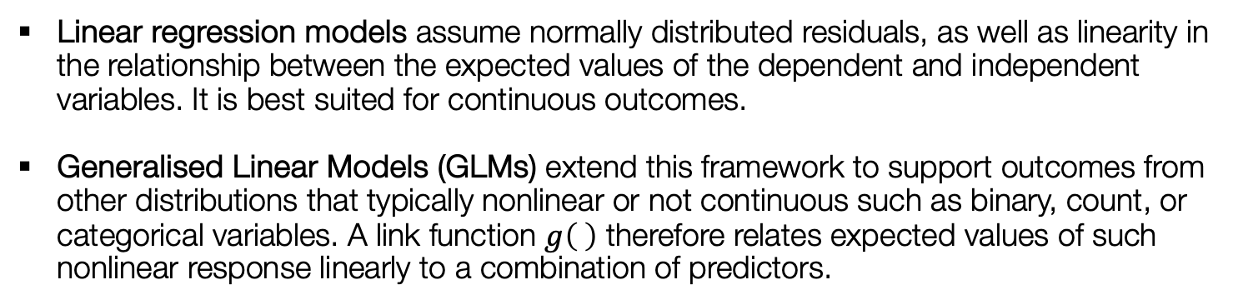

Social Data Institute
What is a link function $g\left(η\right)$? [1]
$$𝔼\left[Y\right]= μ= β_{0}+β_{1}x_{1}+β_{2}x_{2}+…$$
Linear regression models assume normally distributed residuals, as well as linearity in the relationship between the expected values of the dependent and independent variables. It is best suited for continuous outcomes.
Generalised Linear Models (GLMs) extend this framework to support outcomes from other distributions that typically nonlinear or not continuous such as binary, count, or categorical variables. A link function $g\left( \right)$ therefore relates expected values of such nonlinear response linearly to a combination of predictors.
Notes 1: This link function apply applies a transformation to the dependent variable, so its nonlinear relationship can be modelled linearly – its on a transformed scale
$$g\left(…\right)→η= β_{0}+β_{1}x_{1}+β_{2}x_{2}+…$$
Link function apply to some outcome (binary, binomial etc.)
That outcome transformed
accordingly to nu
10

Slide 11


Social Data Institute
What is a link function $g\left(η\right)$? [2]
Here are the most frequent examples which you will certainly encounter
Distribution of dependent variable | Exponential Family (Distribution) | Link Function | Suitable Model
Continuous measures | Normal distribution | Identity (we’ve been using this all this while) | Linear regression
Binary measures (1 = “present” or 0 = “absent”) | Bernoulli distribution | Logit | Logistic Regression
Binomial measure (or proportion) | Binomial distribution | Logit function on aggregated outcome for successful and failures | Logistic Regression
Counts or discrete measures | Poisson distribution | Log or ln | Poisson Regression
11
Notes:
Going to next page: How does one write the null and alternative hypothesis?

Slide 12
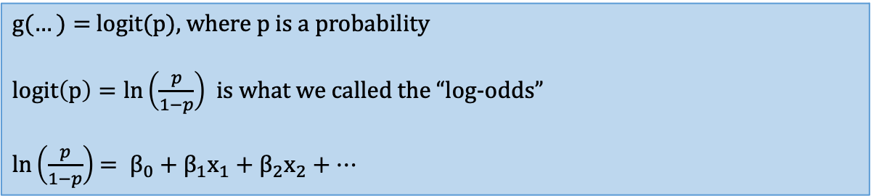
Social Data Institute
Logistic Regression [1]
This model allows the user to model binary outcomes linearly with other independent variables
Examples of such outcomes can be from Bernoulli distribution e.g., disease status: no disease = 0 or disease = 1; Victimisation status: not burgled = 0 or burgled = 1; etc.,
Other examples can also be from a Binomial distribution where binary responses are aggregated: e.g. total number of individual surveyed in a village (N) and number people detected to be positive (n)
Link function:
Notes 1: With binary outcomes, we are dealing with probabilities and not averages
$g(…)=$ logit(p), where p is a probability
$logit\left(p\right)=ln\left(\frac{p}{1−p}\right)$ is what we called the “log-odds”
$ln\left(\frac{p}{1−p}\right)$ $= β_{0}+β_{1}x_{1}+β_{2}x_{2}+…$
12

Slide 13
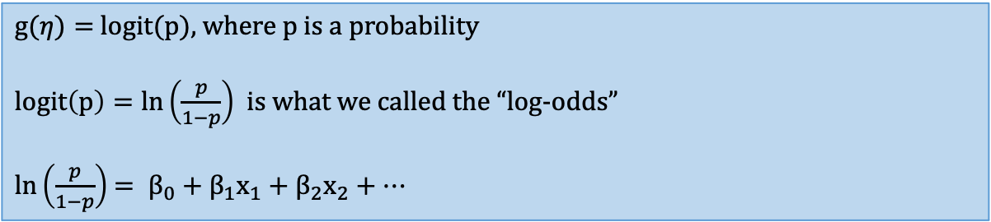
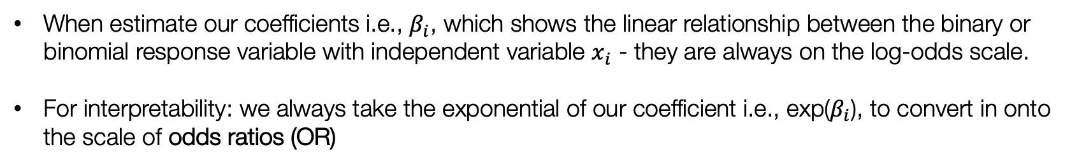
Social Data Institute
Logistic Regression [2]
$g(η)=$ logit(p), where p is a probability
$logit\left(p\right)=ln\left(\frac{p}{1−p}\right)$ is what we called the “log-odds”
$ln\left(\frac{p}{1−p}\right)$ $= β_{0}+β_{1}x_{1}+β_{2}x_{2}+…$
When estimate our coefficients i.e., $β_{i}$, which shows the linear relationship between the binary or binomial response variable with independent variable $x_{i}$ - they are always on the log-odds scale.
For interpretability: we always take the exponential of our coefficient i.e., exp($β_{i}$), to convert in onto the scale of odds ratios (OR)
This is the quantity i.e., Odds Ratios (OR), we want to estimate and interpret from our logistic regression
13

Slide 14
Social Data Institute
Interpretation of Odds Ratios (OR)
OR = 1 (null value), it means that independent variable has no effect on the outcome
OR < 1, the independent variable has an impact on the outcome – in this case, its reduced effect, or reduced risk on the outcome
OR > 1, the independent variable has an impact on the outcome – and so, in this case, its increased effect, or increased risk on the outcome
Notes 1: If you want to do a risk assessment and your study design is either a cross-sectional or case-control study design with some binary/binomial outcome, use a logistic regression model.
14

Slide 15
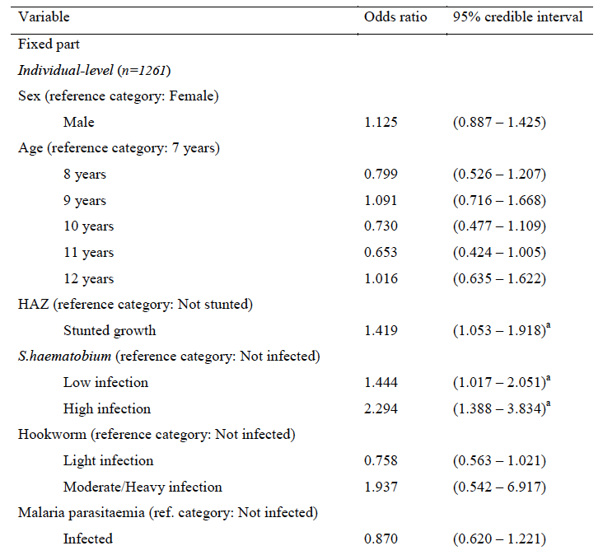
Table: Estimated posterior odds ratios for prevalence of anaemia at baseline, using a
Bayesian hierarchical logistic regression model.
Notes 1: An example of logistic regression model, applied to health risk assessment study I did for my MSc dissertation in 2011, a long time ago, using data from the Schistosomiasis Control Initiative (SCI) for determining the impacts of various parasitic and other factors on risk of anaemia in school children in Tanzania.
Interpretation:
Children at baseline with light S.haematobium intensities were 1.444 times more likely to be anaemic compared to an uninfected children, (95% credible interval: 1.017 – 2.051).
Furthermore, those with heavy S.haematobium intensities are at more than twice the risk of being anaemic (Odds ratio: OR = 2.294, 95% credible interval: 1.388 – 3.834).
15

Slide 16
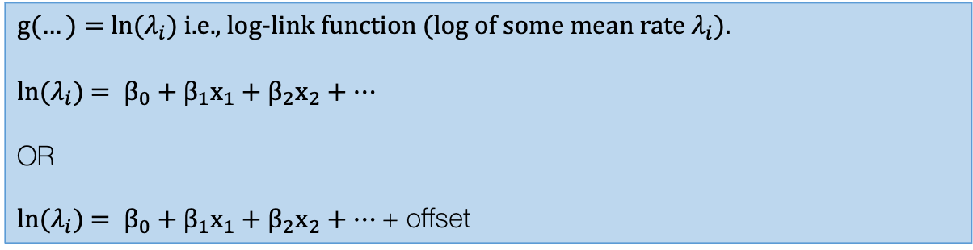
Social Data Institute
Poisson Regression [1]
This model allows the user to model count or discrete outcomes linearly with other independent variables
Examples of such outcomes can be from Poisson distribution e.g., number of COVID cases in postcodes across London; Number of houses on street segments that were victims to burglary etc.
With particular scenario we are dealing with aggregated units and its either counts or rates
Link function:
$g(…)=$ ln($λ_{i}$) i.e., log-link function (log of some mean rate $λ_{i}$).
ln($λ_{i}$) $= β_{0}+β_{1}x_{1}+β_{2}x_{2}+…$
OR
ln($λ_{i}$) $= β_{0}+β_{1}x_{1}+β_{2}x_{2}+…$+ offset
Often an offset is include to adjust for denominators if the outcome was measured as a rate.
16

Slide 17
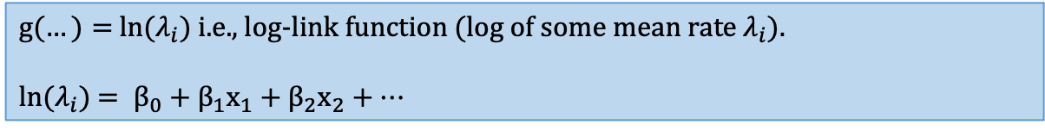
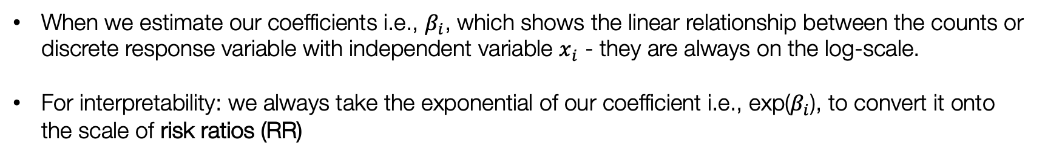
Social Data Institute
Poisson Regression [2]
$g(…)=$ ln($λ_{i}$) i.e., log-link function (log of some mean rate $λ_{i}$).
ln($λ_{i}$) $= β_{0}+β_{1}x_{1}+β_{2}x_{2}+…$
When we estimate our coefficients i.e., $β_{i}$, which shows the linear relationship between the counts or discrete response variable with independent variable $x_{i}$ - they are always on the log-scale.
For interpretability: we always take the exponential of our coefficient i.e., exp($β_{i}$), to convert it onto the scale of risk ratios (RR)
This is the quantity i.e., Risk Ratios (RR) (interchangeable with Relative Risk), we want to estimate and interpret from our Poisson regression
17
Notes:
?

Slide 18
Social Data Institute
Interpretation of Risk Ratios (RR)
RR= 1 (null value), it means that independent variable has no effect on the outcome
RR < 1, the independent variable has an impact on the outcome – in this case, its reduced effect, or reduced risk on the outcome
RR > 1, the independent variable has an impact on the outcome – and so, in this case, its increased effect, or increased risk on the outcome
Notes 1: Use the relative risks - if you want to do a risk assessment for ecological study design where you have counts as the outcome (and denominators for offset – for rates). Also use this as well for individual-level cohort studies when following groups of participants prospectively
18

Slide 19
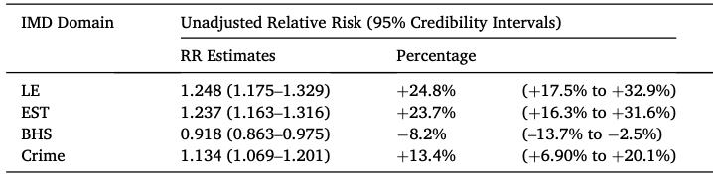
Table: Estimated posterior relative risks exploring the overall association for area-level socioeconomic deprivation with fire-related casualty rates in residential dwellings in England
Notes 1: An example of Poisson-based regression model, applied to fire-related casualty risk within home dwellings, spatially, across Fire Service Areas in England.
Interpretation:
When the levels of deprivation at an FSA-level increase, we found the following for the domains: Living Environment and Education, Skills & Training, significantly increases the risk of fire-related dwelling
casualties by up to 25.0% in England. For elevated levels of crime, the risk of fire-related dwelling casualties increases 13.4%.
Li et al. 2022 [Source]
19

Slide 20
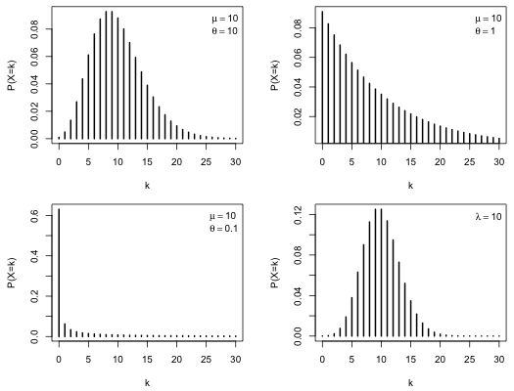
Types of Poisson Regression
Examine the frequency distribution of the count response
Scenario 1: Little to no dispersion
Use: regression Poisson model
Scenario 2: Over dispersed
Use: Negative Binomial Poisson model
Scenario 3: Strong over-dispersed response
Use: Zero-inflated Poisson model
Use as last restore if scenario is gives you unstable results.
20

Slide 21
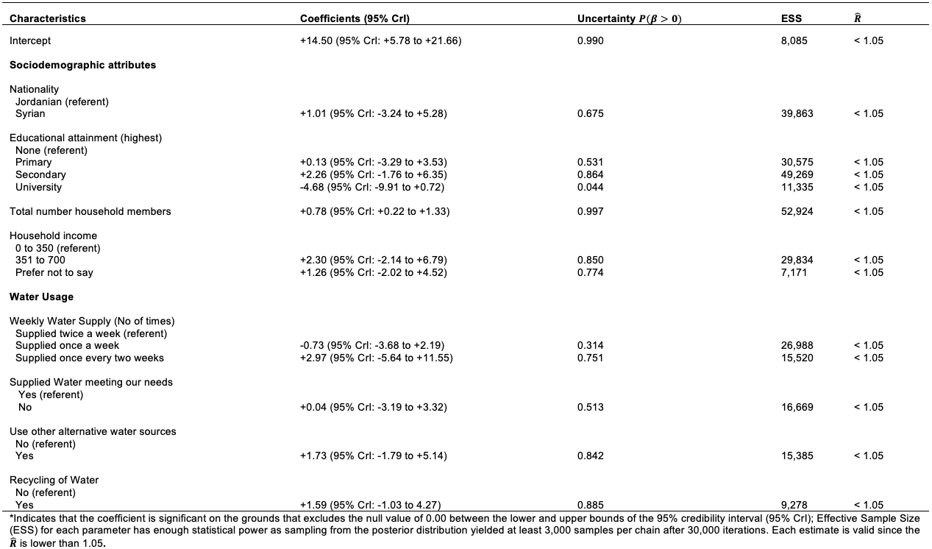
Example with exceedance probabilities
Linear model
21

Slide 22
Social Data Institute
How do you code a Bayesian GLM in RStudio? [1]
Specifications for model block:
Linear regression: norm()
Logistic regression (Y : 1 or 0): bernoulli_logit()
Logistic regression (Y : numerator & denominators): binomial_logit()
Poisson regression (Y : counts or rates; normal): poisson_log()
Poisson regression (Y : counts or rates; over-dispersed or zero-inflated): neg_binomial_2_log()
Let’s look at a simple linear regression case
22

Slide 23
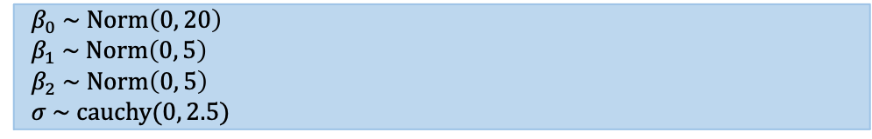
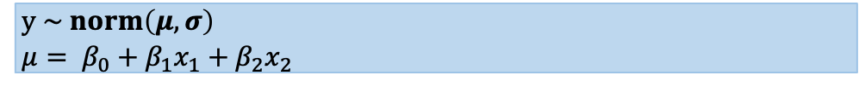
Social Data Institute
Stan code
Model formulation
data {
int<lower=0> N; // sample size N
int<lower=0> k; // number of variables 2
matrix[N, k] X; // matrix: independent variables
vector[N] y; // vector/array for outcome
}
parameters {
real beta0; // Intercept
vector[k] beta; // beta coefficients
real<lower=0> sigma; // standard deviation
}
transformed parameters {
vector[N] mu;
mu = beta0 + X*beta;
}
model {
beta0 ~ normal(0, 20); // Prior for beta0
beta ~ normal(0, 5); // Prior for beta1 and 2
sigma ~ cauchy(0, 2.5); // Prior for sigma
y ~ normal(mu, sigma); // Likelihood function
}
Simple GLM (Linear case)
$$y = β_{0}+β_{1}x_{1}+β_{2}x_{2}+ε$$
Specify likelihood function. The outcome is continuous – thus it normal (so no link function is need here).
$$y \sim norm\left(μ, σ\right)$$
$$μ= β_{0}+β_{1}x_{1}+β_{2}x_{2}$$
Define the priors for the intercept, coefficients and other parameters, e.g., standard deviation
$${ β}_{0} \sim Norm\left(0, 20\right)$$
$${ β}_{1} \sim Norm\left(0, 5\right)$$
$${ β}_{2} \sim Norm\left(0, 5\right)$$
$$σ \sim cauchy(0, 2.5)$$
Build Bayesian model
Recall the Bayes’ Rule: $P\left(θ | Y\right)∝P\left(Y | θ\right)P(θ)$
$$P\left({β_{0},β_{1},β_{2}, σ}_{ } | μ\right)∝P\left(μ | β_{0},β_{1},β_{2},σ\right) P\left(β_{0,}\right)P\left(β_{1}\right)P\left(β_{2}\right)P(σ)$$
23

Slide 24
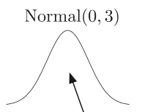
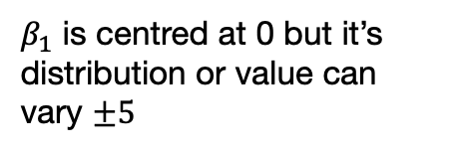
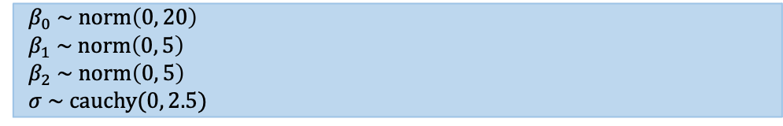


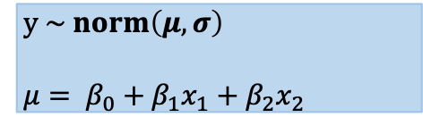
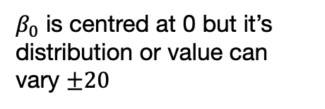
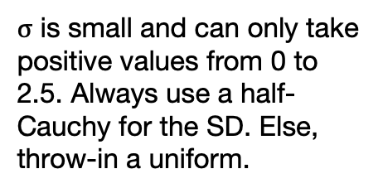

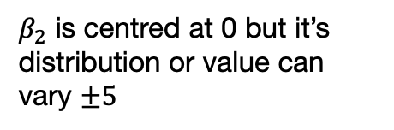

This is my model
These are my priors for the coefficients and standard deviation
$$y \sim norm\left(μ, σ\right)$$
$$μ= β_{0}+β_{1}x_{1}+β_{2}x_{2}$$
$${ β}_{0} \sim norm\left(0, 20\right)$$
$${ β}_{1} \sim norm\left(0, 5\right)$$
$${ β}_{2} \sim norm\left(0, 5\right)$$
$$σ \sim cauchy(0, 2.5)$$
What are we saying?
Intercept
Coefficient for variable 1
Coefficient for variable 2
Standard deviation
${ β}_{0} \sim$norm(0, 20)
${ β}_{1} \sim$norm(0, 5)
${ β}_{2} \sim$norm(0, 5)
$$σ \sim cauchy(0, 2.5)$$
-20
0
+20
-5
0
+5
-5
0
+5
+2.5
0
$β_{0}$ is centred at 0 but it’s distribution or value can vary $±20$
$β_{1}$ is centred at 0 but it’s distribution or value can vary $±5$
$β_{2}$ is centred at 0 but it’s distribution or value can vary $±5$
$σ$ is small and can only take positive values from 0 to 2.5. Always use a half-Cauchy for the SD. Else, throw-in a uniform.
24

Slide 25

Any questions?
25

